Slide 1

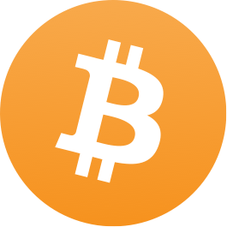
Introduction and Overview of Bitcoin
Anjali Kamath
General Counsel and Compliance Manager

Slide 2

AGENDA
What is Bitcoin
Background on BitPay
Benefits of Using Bitcoin
Regulatory/Compliance Challenges

Slide 3
Satoshi Nakamoto
Attributed with the creation of Bitcoin, a type of cryptocurrency
Published Whitepaper in 2008:
“Bitcoin: A Peer to Peer Electronic Cash System”
Name is an alias; True identity unknown

Slide 4
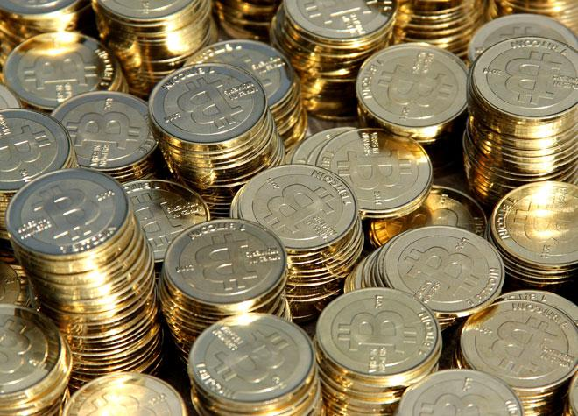
What Exactly is Bitcoin?
Digital Currency: A form of currency or medium of exchange that is electronically created and stored.
Cryptocurrency: A type of digital currency that uses cryptography for security and anti-counterfeiting measures by securing the transactions and controlling the creation of new units.
cryptography: a method of storing and transmitting data in a particular form so only those for whom it is intended can read and process it.

Slide 5
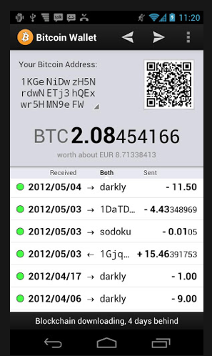

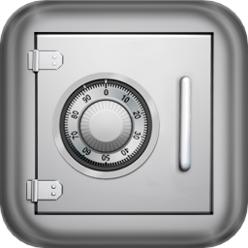
Where do you store them?
Bitcoin storage devices are referred to as wallets.
Web-based (Hot wallet)
Software
Offline storage- USB, paper, etc (Cold wallet or cold storage)
External hardware device

Slide 6
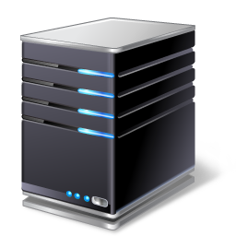
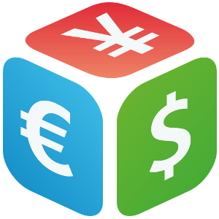


How do you acquire Bitcoin?
Mining
Exchanges
Individuals
In exchange for goods/services

Slide 7
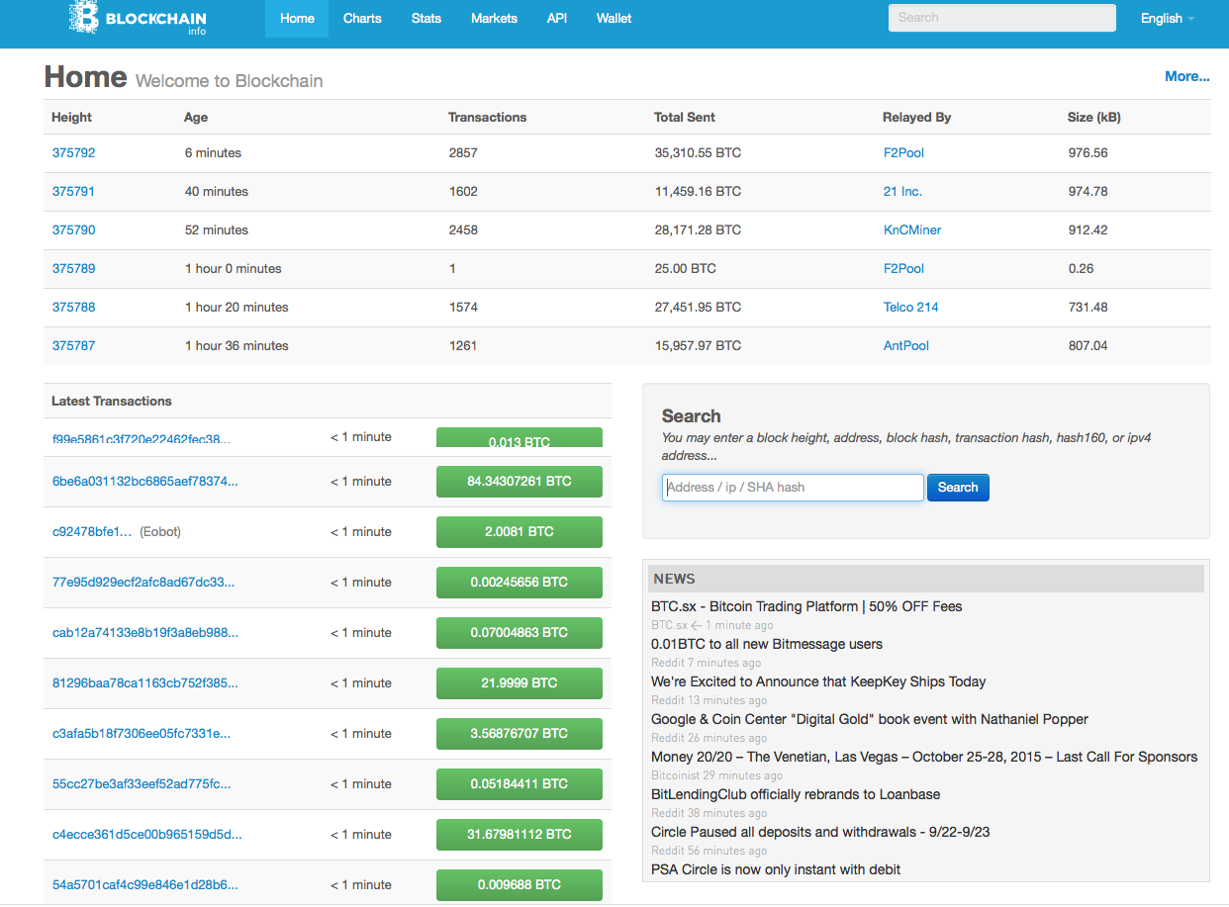
the Blockchain
The blockchain is a public ledger of all bitcoin transactions in the bitcoin network.

Slide 8
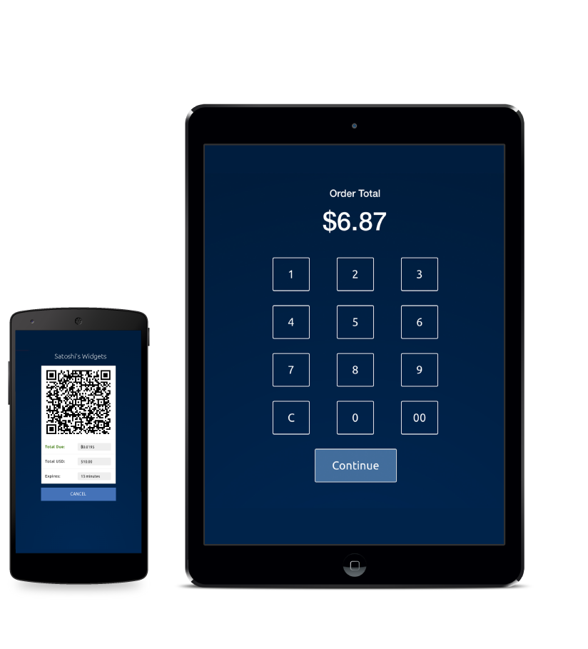
WHO WE ARE
BitPay is a Merchant Processor, providing payment processing solutions for Merchants wanting to accept bitcoin as payment for goods and/or services.
We currently offer:
Point of Sale Apps for retail stores
Online solutions for ecommerce

Slide 9
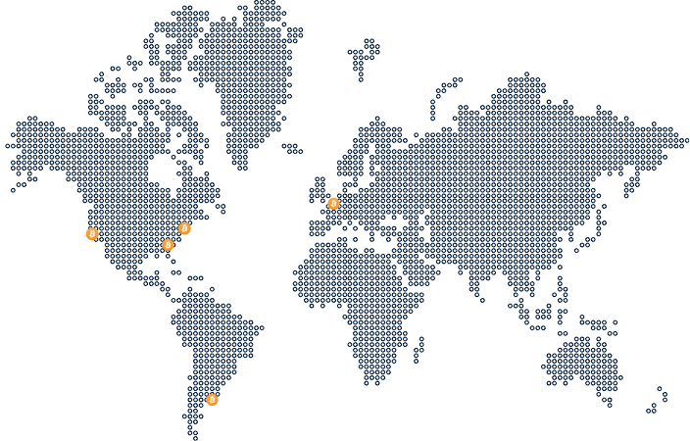
WHO WE ARE
World’s first bitcoin payment processing gateway
Only service businesses
Wallet agnostic
Guaranteed exchange rate
No transaction fees or chargebacks
Daily bank settlement in 9 currencies and 33 countries

Slide 10

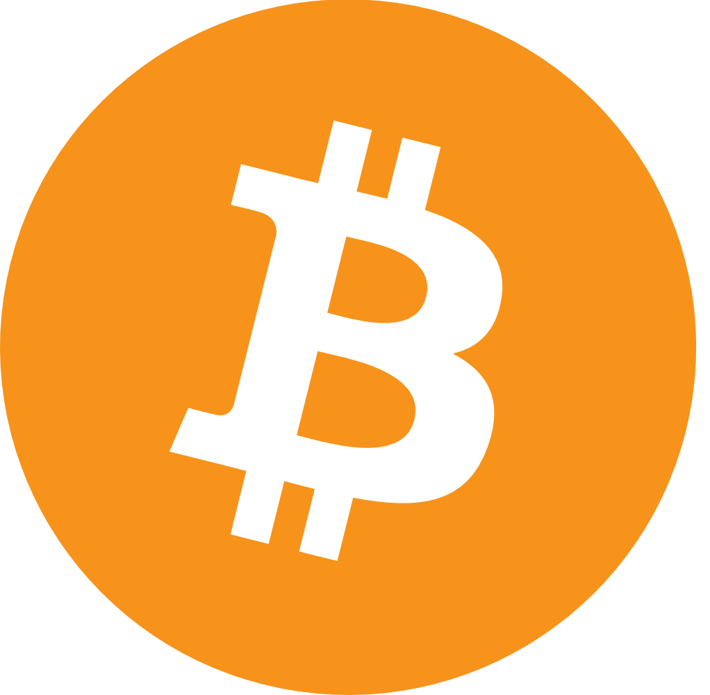

May 2011
BITPAY FOUNDED
SAN FRANCISCO
AMSTERDAM
70
EMPLOYEES WORLDWIDE
ATLANTA
60,000
MERCHANTS WORLDWIDE
$32,700,000
CAPITAL RAISED
Index Ventures
Founders Fund
Horizons Ventures
RRE Ventures
Felicis Ventures
TTV Capital
Richard Branson
Jerry Yang
TUCUMAN
BUENOS AIRES

Slide 11
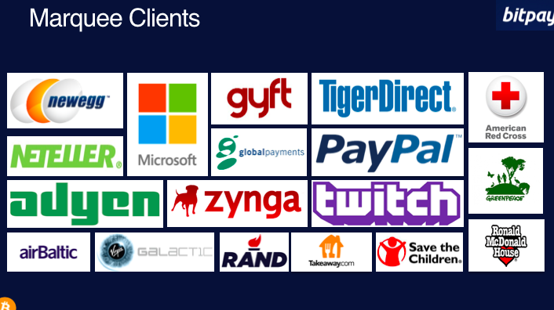

Slide 12
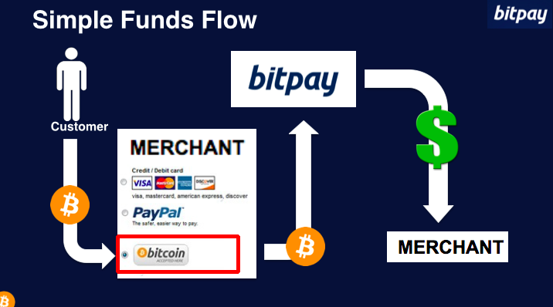
How does it work?

Slide 13
Why Bitcoin?
No chargebacks
No risk of fraud or identity theft
Anonymous (to a certain extent)
You own it and no one can take it away from you
Ease of use: Fast, secure, and global; little to no fees
Not subject to inflation
Accessible to the “unbanked”
Notes:
instant money transfers internationally with little to no fees

Slide 14
BitPay’s Compliance Program
Designation of Chief Compliance Officer
Tailored Internal Policies, Procedures, Controls
BSA/AML Program
Ongoing, Relevant Training of Employees
Independent Compliance Review

Slide 15
ANY QUESTIONS?

